Slide 1
Title font - Rockwell
Body font – Bariol Regular – Body font – Bariol Regular Body font – Bariol Regular – Body font – Bariol Regular
Body font – Bariol Regular
Notes:
Thanks for downloading the PowerPoint template. The first things you’ll need to do are to set up your colour palette, decide what fonts you are going to use and also set up your slide background as described in chapter one.

Slide 2
Title slide – add name here
Title slide – add other details here
Notes:
Make sure you apply the fonts and the background across the rest of the template.

Slide 3
Add agenda title here
Agenda item 1
Agenda item 2
Agenda item 3
Notes:
The agenda slide and the section title slide that follows this one should be differentiated from the rest of the template so that they can be used as signposts in your presentation.

Slide 4
Add section title here

Slide 5
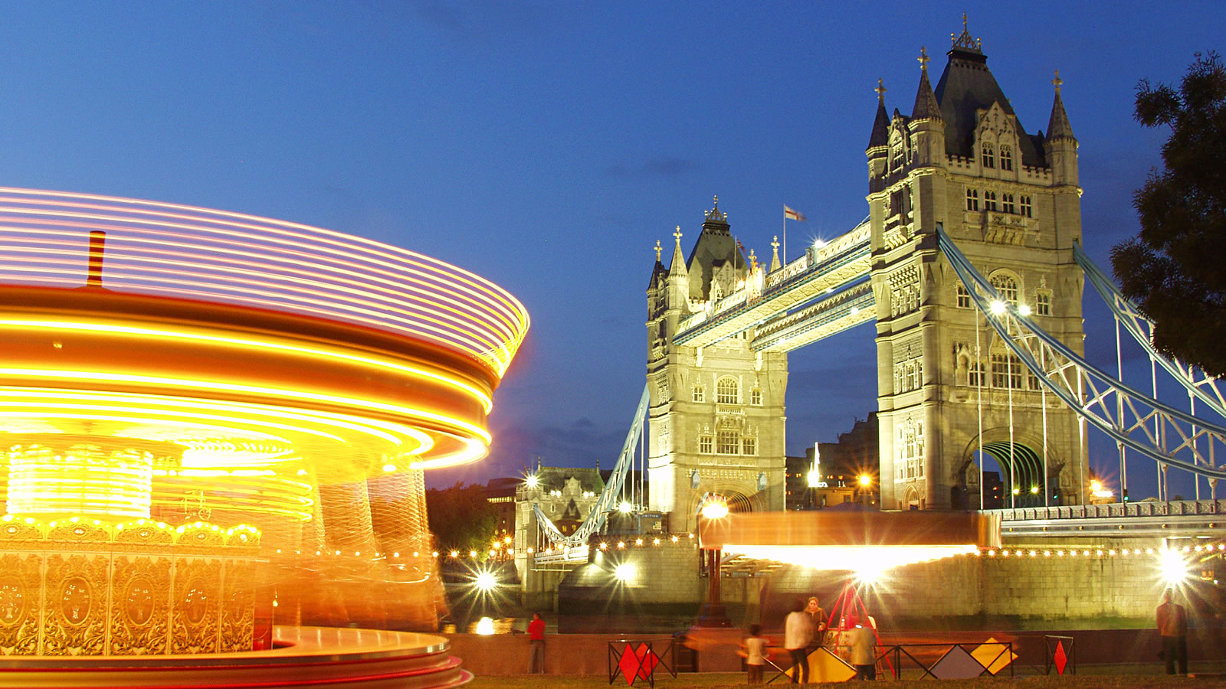
Add title here
Add text here
Notes:
Make your full image 1,600 pixels wide (left to right). See chapter 6 for more information.

Slide 6
Add title here
Add text here
Notes:
Make your half-width image 800 pixels wide (left to right). See chapter 6 for more information.

Slide 7
Add title here
Add body text here
Add body text here
Add body text here
Add body text here

